Slide 1
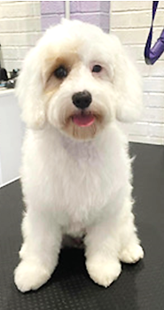
School Dog Passport
Mabel
Our School Dog

Slide 2
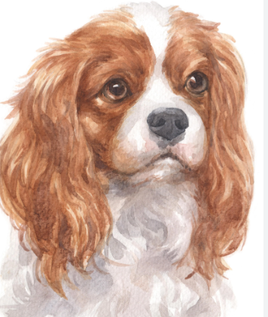
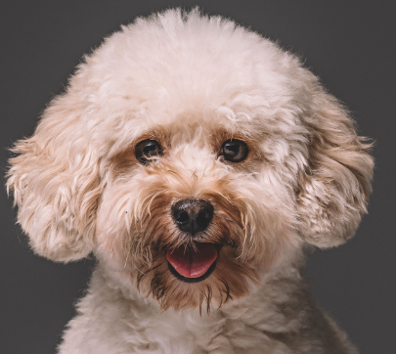
What breed am I?
I am a cavapoo, which means that I am half Cavalier King Charles Spaniel and Toy Poodle. My mum is a Cavalier King Charles Spaniel and my dad is a Toy Poodle
My Hobbies
I like playing with my toys, walking, running through long grass, eating and sleeping. I also enjoy being stroked and cuddled
Who are my humans?
What three words would describe me?
My humans are Mrs Barker-Doe and her family. Sometimes I will have sleep overs with her family and friends
What do you like best about being a dog?
Cuddly, calm and friendly
I love seeing the children in the day and having my belly rubbed! I love listening to children read

Slide 3
What is your favourite book and why?
What do you like to play with?
Anything with a rope that I can pull and I love tennis balls!
I like all books. I really enjoy being read to by everyone, including adults!
What is your favourite place?
I have had many holidays with Mrs Barker-Doe and her family. My favourite places are anywhere that has long grass, as I like to hide from them. This is good fun!
What made you want to be a school dog?
I am calm and very friendly. I am a good listener too. Mrs Barker-Doe wanted a school dog to look after the children if they need help and my personality was just right for that job
Do you have any brother and sisters?
I came from a large litter of puppies and we all have very happy homes with families that love us

